Slide 1

101: Getting Started with Collaborator

Slide 2

Meet the team
Jon Fortunati

Slide 3
Announcements
This class is being recorded
Please direct all questions to the Q & A box
Chat is disabled but we will use it to send links
We may ask for you to “Raise Your Hand”
Please provide feedback in the exit survey

Slide 4

Want more free training?
Academy

Slide 5
For any additional questions, email us at customers@smartbear.com

Slide 6
Notes:
Animated SmartBear logo

Slide 7
SmartBear enables quality across the SDLC through innovative, easy to use tools that seamlessly integrate with your ecosystem, methodology and process

Slide 8

Who is SmartBear?
Boston, MA, USA, based with 11 offices globally
Founded in 2009
Open Source Contributor (Swagger & SoapUI)
6.5 Million Users
20,000+ Customers

Slide 9
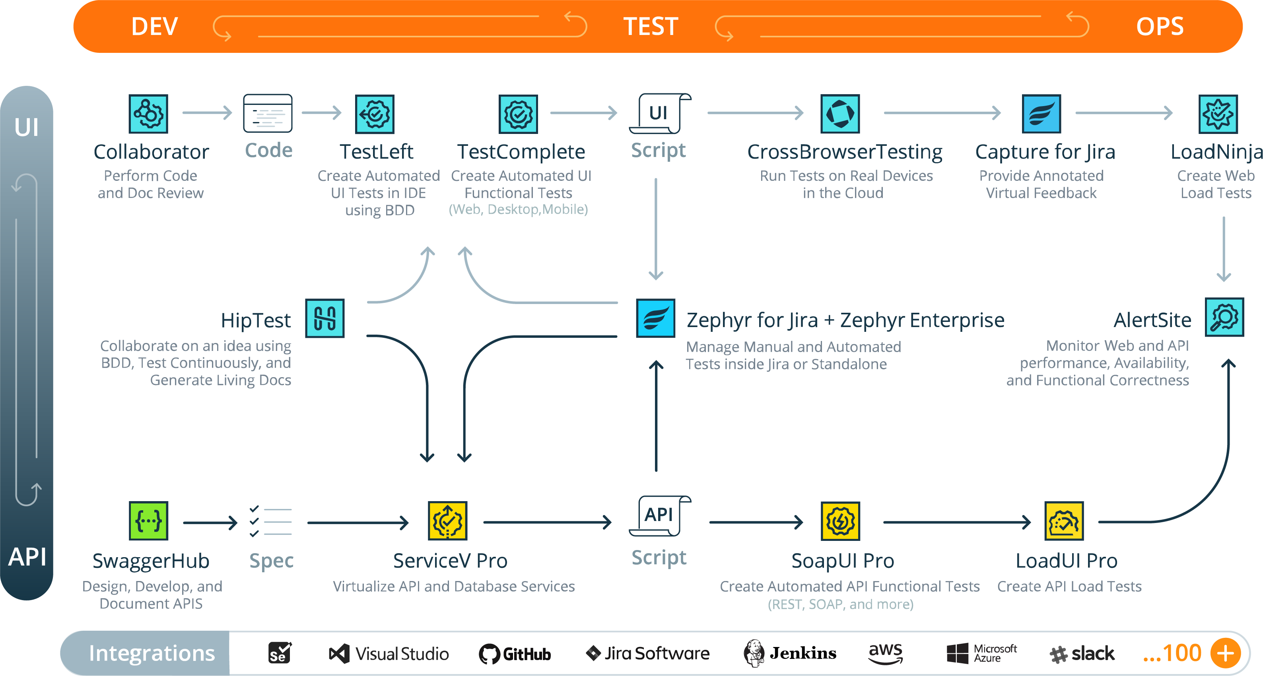

Slide 10

Agenda
Code Review Benefits
Best Practices of Code Review
Getting the Most out of Collaborator

Slide 11
Code Review Benefits
The Quantitative
The Qualitative
Finding bugs earlier
Passing the bug test
Connecting the digital thread
Team building
Personal growth

Slide 12
Best Practices
Checklists
Author annotating
60-90 minutes
200-300 LOC changed

Slide 13
Thank You

